Slide 1
时间(shí jiān) 2016年12月6日
Copy the title and date. What do you notice about the characters in the title? What do you think they might mean? Have a go at the vocabulary challenge below – can you get as far as the green section? Translate English into characters and Chinese into English ☺
我哥哥是大学生，上一年级。
My younger brother is 10, he is a primary school student.
I am a secondary school student, I am in Year 7.
他不是英国人，他一半是美国人，一半是意大利人。
Is your dad French?
That person is half German, half English.
我爸爸工作，他是经理。你爸爸呢？
My mum doesn’t work. My dad is an engineer, he works in London.

Slide 2
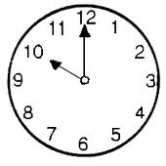
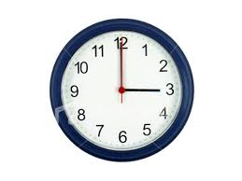
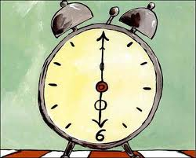
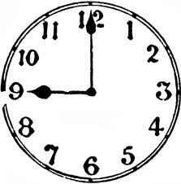
现在几点？xiànzài jǐ diǎn？
现在十点。
1
2
3

Slide 3
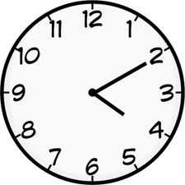
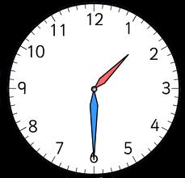
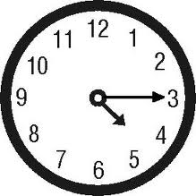
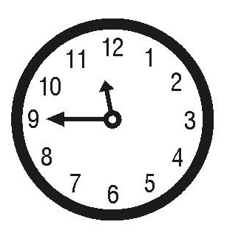
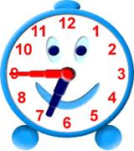
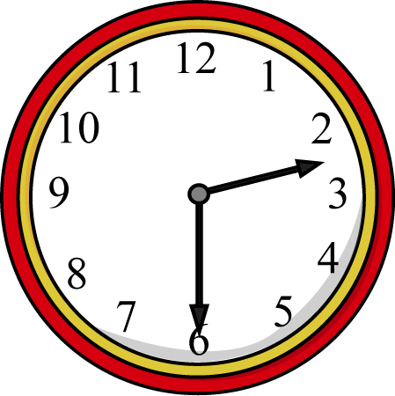
现在几点？xiànzài jǐ diǎn？
现在四点十分(fēn)。
现在一点半。
现在四点一刻(kè)。
1
2
3

Slide 4
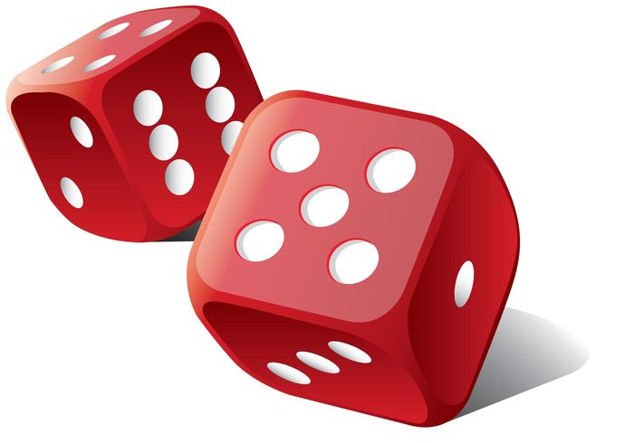
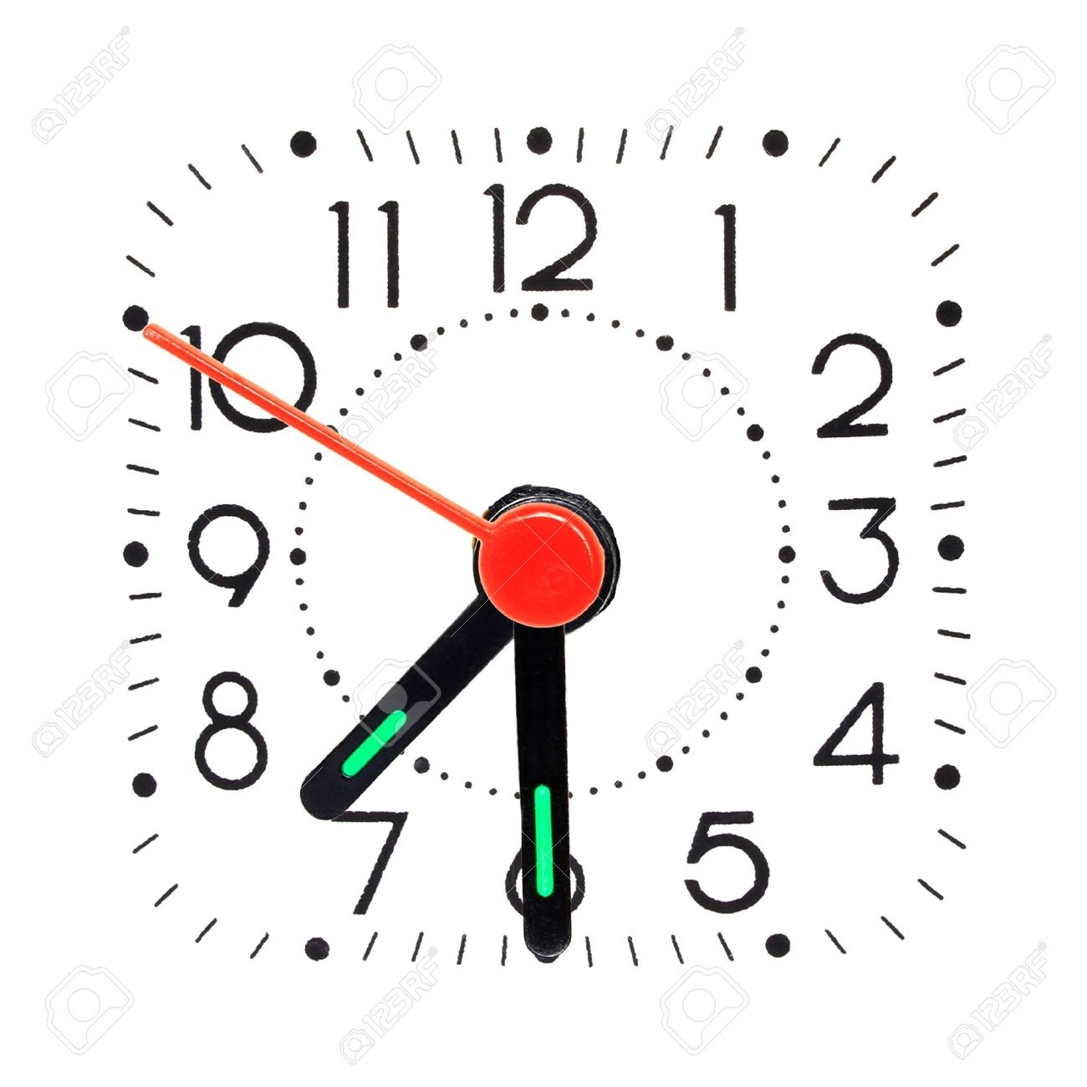
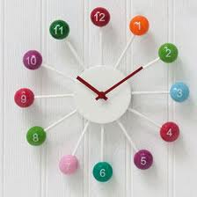
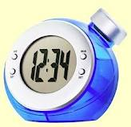
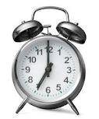
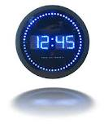
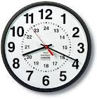
现在几点？xiànzài jǐ diǎn？
分 fēn = minutes 刻 kè = quarter
1
2
3
4
5
6

Slide 5
 | Left hand up
 | Right hand up
 | Both hands up
三点 |  | 六点
八点半 |  | 十点一刻
七点一刻 |  | 一点半
两点二十分 |  | 十二点三刻
九点三十五分 |  | 十一点五十分

Slide 6
时间(shí jiān) 2016年12月6日
Task: Complete reading and writing exercise on your sheet (write the times in characters) and then stick it into your exercise book.
diǎn = o’clock
fēn = minutes
kè = quarter
Extension: Copy the question 现在几点？and then write the answer for the time now in your exercise book.

Slide 7
现在几点？xiànzài jǐ diǎn？
1
2
3
4
5
6

