Slide 1
Classroom language 2016年9月21日
Leave a space to finish writing your dialogue, then copy the title and date into your exercise book. Can you see any language around the room which might be useful? How do you say it? What does it mean?
zhōngwén kètáng
中文课堂！
Stick the ‘Essential Classroom Language’ sheet into the back of your blue exercise book (inside the blue cover)

Slide 2
zhōngwén zěnme shuō？
…中文怎么说？
How do you say… in Chinese?
yīngwén zěnme shuō？
…英文怎么说？
How do you say… in English?

Slide 3
…zěnme xiě？
…怎么写?
How do you write…?
…zěnme niàn？
…怎么念?
How do you read…?

Slide 4
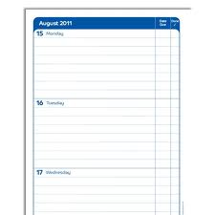
我的书
Wǒ de shū
Wǒ wàng le…
我的笔
我忘了
bǐ
我的作业
I have forgotten…
zuòyè
我的日记
rìjì

Slide 5
2
…中文怎么说？
1
zhōngwén zěnme shuō？
…怎么写?
3
…zěnme xiě？
…怎么念?
…zěnme niàn？
4
…英文怎么说？
yīngwén zěnme shuō？
5
我忘了…
Wǒ wàng le…

Slide 6
2
…中文怎么说？
1
…怎么写?
3
…怎么念?
4
…英文怎么说？
5
我忘了…

Slide 8
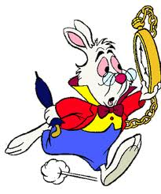
Duìbuqǐ, wǒ chí dào le!
对不起,我迟到了!
Sorry I’m late!

Slide 9
1. Sorry I’m late!
2. How do you say… in English?
3. I have forgotten…
4. How do you write…
5. How do you read…
6. How do you say… in Chinese?

Slide 10
说英文
shuō yīngwén
Wǒ kěyǐ
ma?
我可以
去音乐课
吗？
Can I…
qù yīnyuè kè
上厕所
shàng cèsuǒ

Slide 11
作业
Learn to recognise characters and pinyin, and write characters for greetings (but not ‘being polite’) pg. 12-13 in your yellow vocabulary booklet
Complete exercises on pg. 10, 13 & 14
Copy greetings characters
Workbook, pg. 21-23: exercise 1, 2, 3, 5, 9, 11 - Write your answers on the sheets
星期二 (Tuesday)

